Slide 1



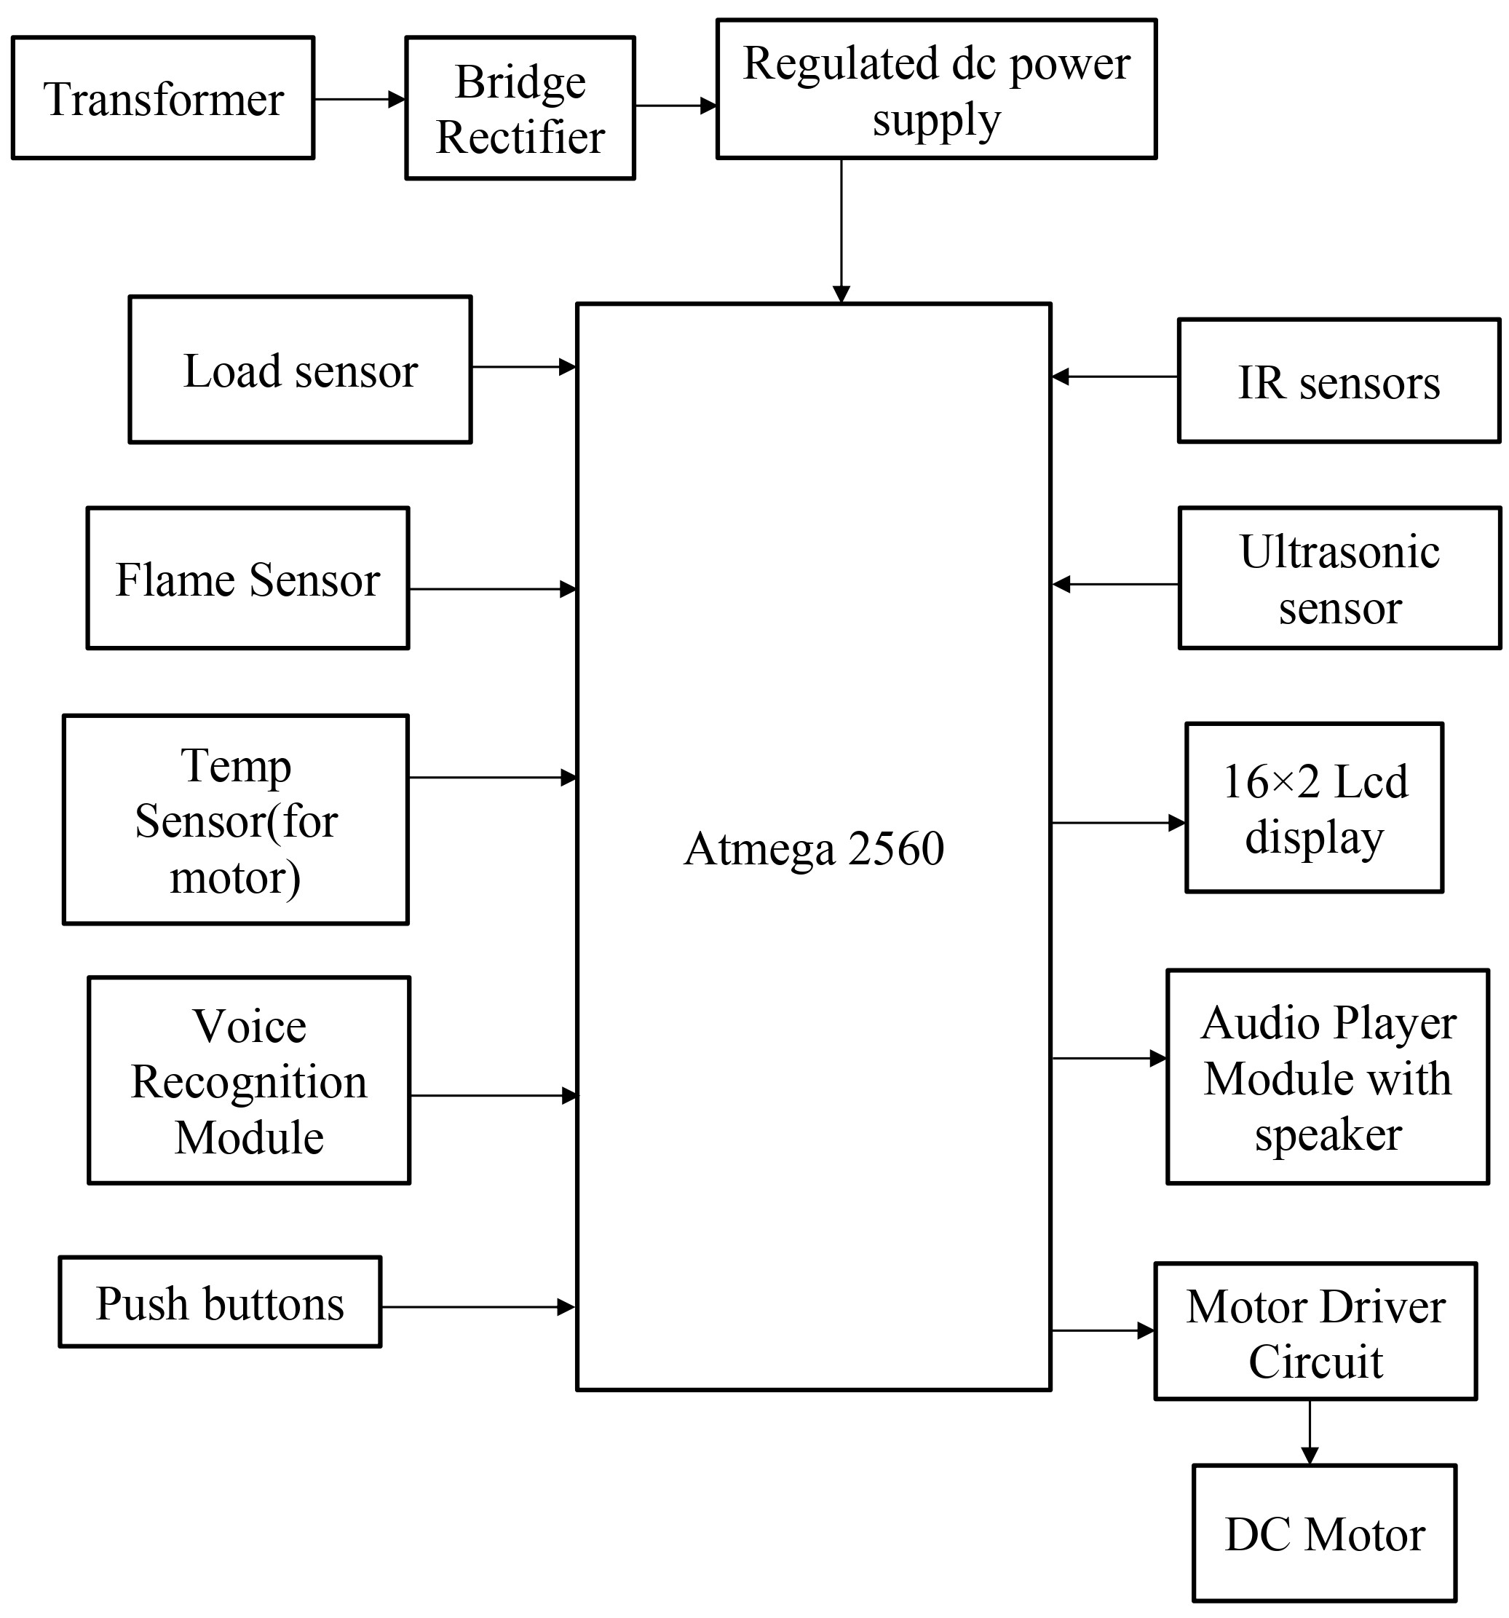
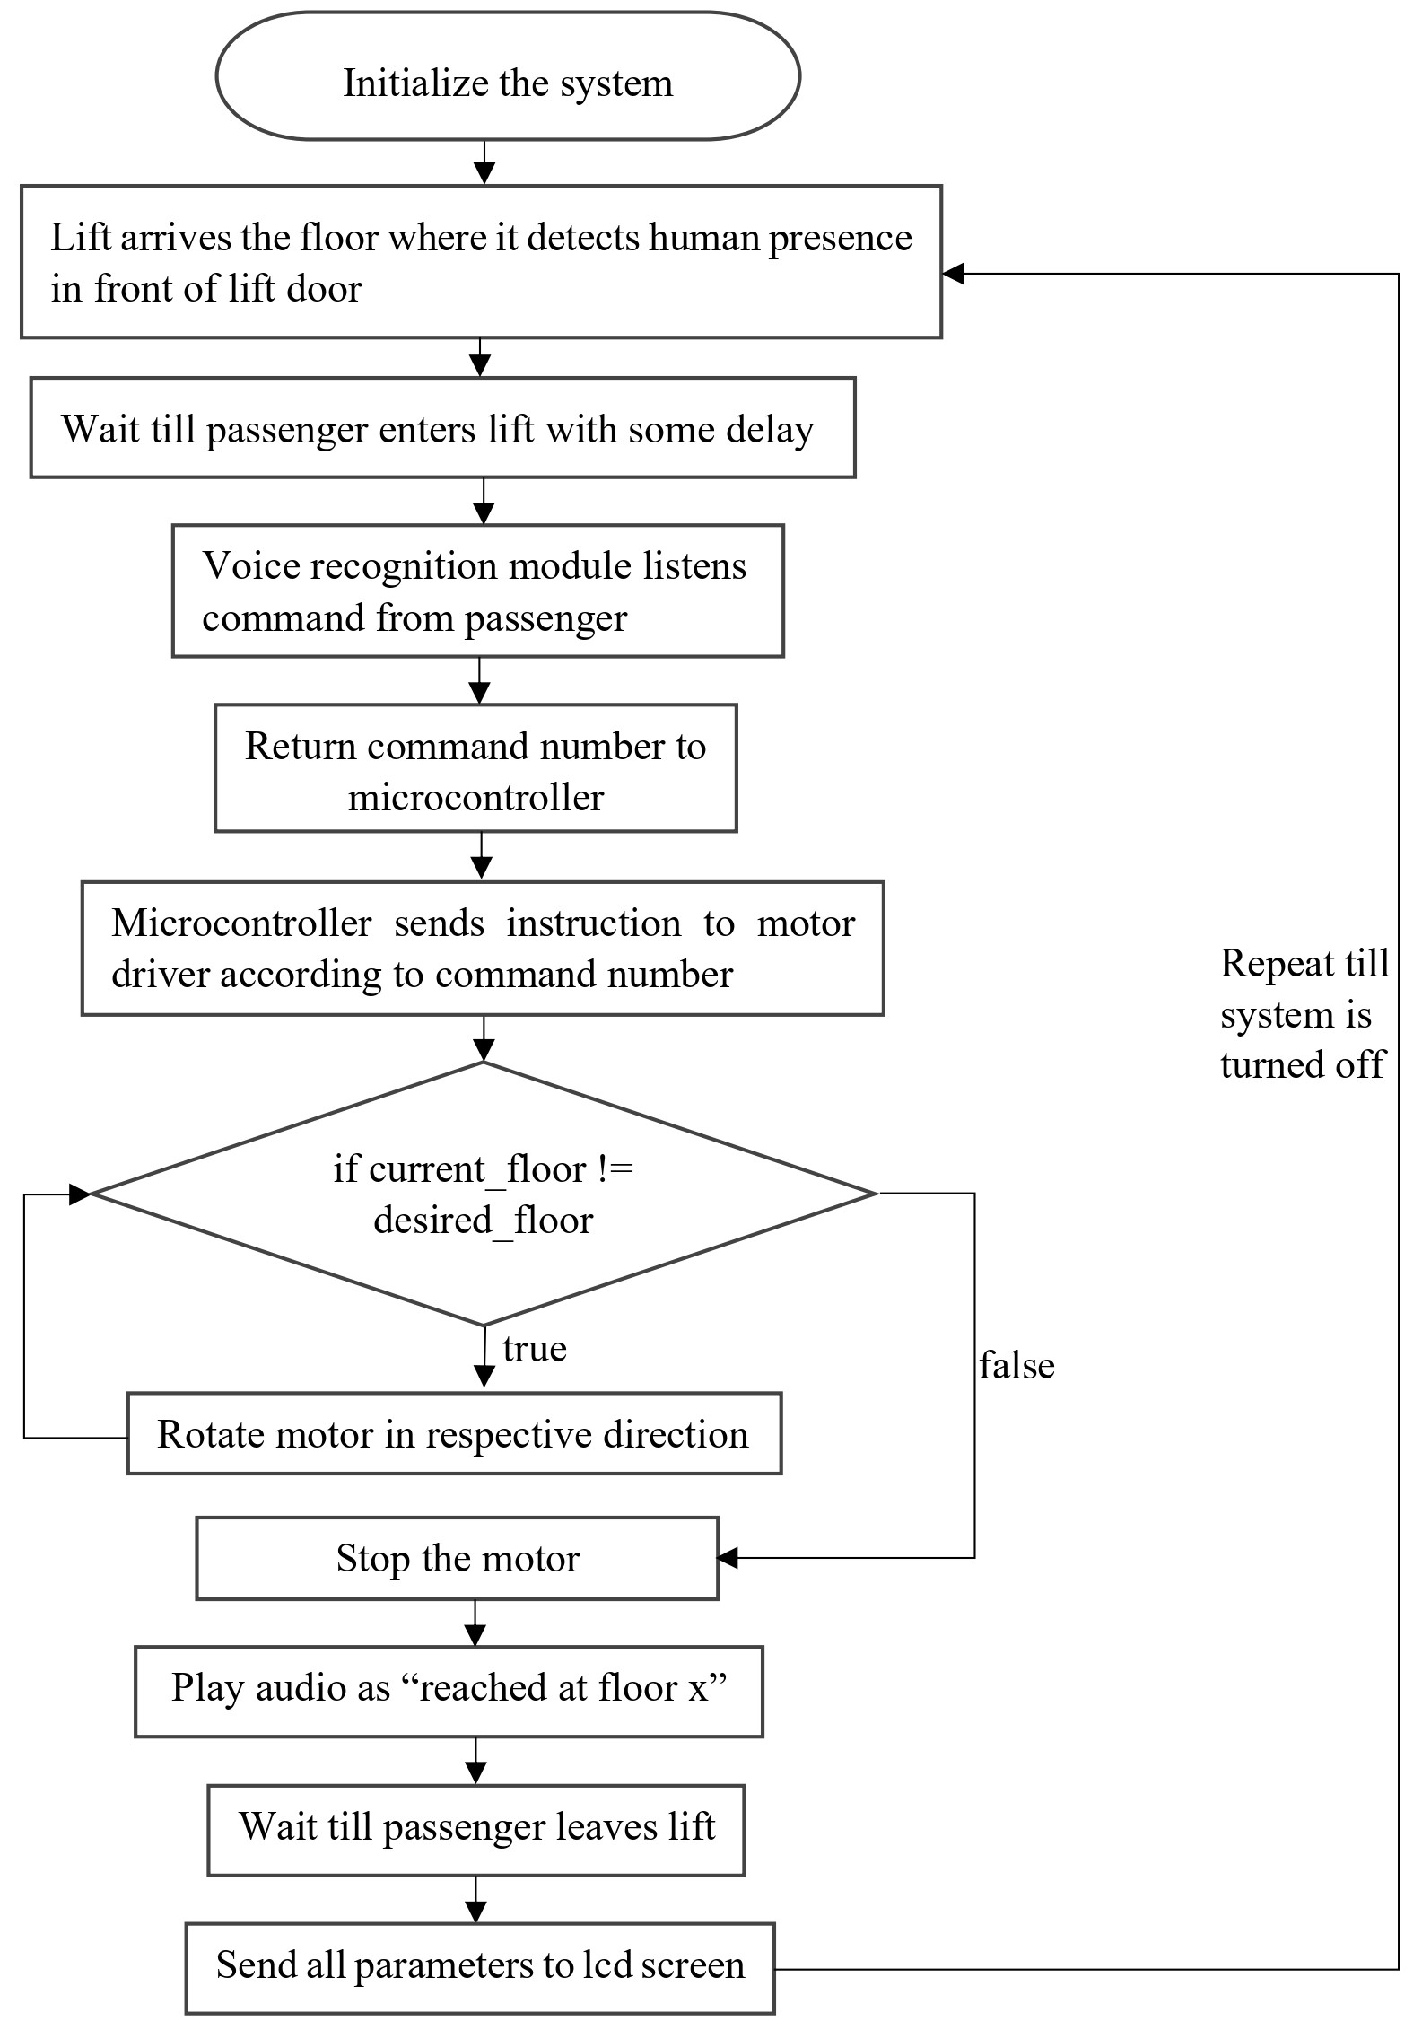
“Voice operated lift control system with safety”
[1] Onkar Waman, [2] Shaileshkumar Zanjare, [3] Aditya Varpe, [4] Gayatri Bhoknal
Guide- Prof. V. R. Aware
Department of Electronics & Telecommunication Engineering
Amrutvahini college of Engineering, Sangamner
Introduction
Physically challenged people face many problems every day. One of these challenges is the use of elevators in many buildings. They should be able to enjoy using the elevator easily.
To overcome this, we must focus on the following issues: Make sure the person is at the elevator door, get elevator there and ask person where to go and accordingly go to respective floor.
Speech recognition is becoming more perplexing and difficult task. The speech recognition research is focuses mainly on large vocabulary, continuous speech capabilities and speaker independence[1].
A voice-operated elevator system is proposed where the user’s input commands to control the movement of the elevator system are kept convenient for the users. The commands include voice input for the floor operations, directions, elevator car’s door operation, and a special command to call for emergency[2].
Need of Project
The visually challenged people cannot use the elevator easily. Sometimes the keypad has Braille technique, but they will have hard time for locating it. They always need help in elevators from someone to press the button for them and to tell them when the elevator cabin arrives.
One more drawback of the current lift is that it cannot tell on which floor the lift is stuck, nor the parameters like temperature of motor, fire detection inside the lift. But by using this voice operated lift we can solve all these problems.
Objectives
To operate lift through voice commands with easy use for people with visual and physical challenges.
To measure parameters like floor number, weight of the lift, fire detection, temperature of motor.
To give real time information of lift parameters on the lcd screen.
Methodology:
System Design
Development and Testing
Deployment and Monitoring
Maintenance
Block Diagram
Flowchart
Results and Discussion
Safety features: The built-in temp sensor successfully halted a lift when exceeding maximum motor temp.
Parameters: All the system related parameters were correctly received on the inbuilt LCD display of the system.
Voice recognition: Almost all commands were recognized by voice recognition module in medium noisy surrounding.
Advantages
Convenience
Hygiene
Safety Features
Modernization high-tech feel
Application
Hospitals: In hospitals, voice control can be helpful for patients and staff who may have difficulty using traditional buttons.
Hotels: Voice-operated lifts can be a modern addition to hotels.
Residential buildings
Public buildings
Conclusion
Voice-controlled elevators are a long-term solution that can be used by anyone, including people with disabilities. They have the potential to make life easier for everyone. In addition, this elevators could also be used to improve security and convenience. For example, authentication could be used to restrict access to certain floors, and sensors could be used to reduce the need for users to give specific commands.
Future Scope
Biometric authentication: Combine voice recognition with facial or fingerprint recognition for enhanced security and personalized settings.
Virtual assistants: Integrate voice assistants(e.g., Alexa) for broader control of building features and information access within lifts.
Multi-modal interactions: Combine voice control with touch screens for alternative input options and enhanced accessibility.

